Slide 1
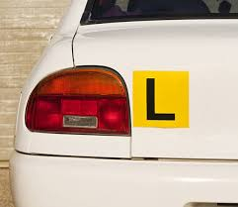
L’s?
What do I have to do and know?

Slide 2
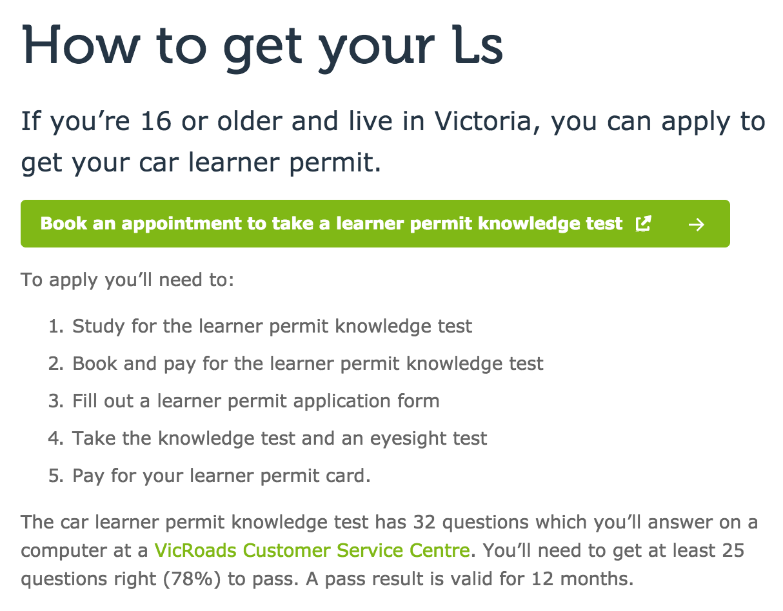
Steps to Getting Your L’s….

Slide 3
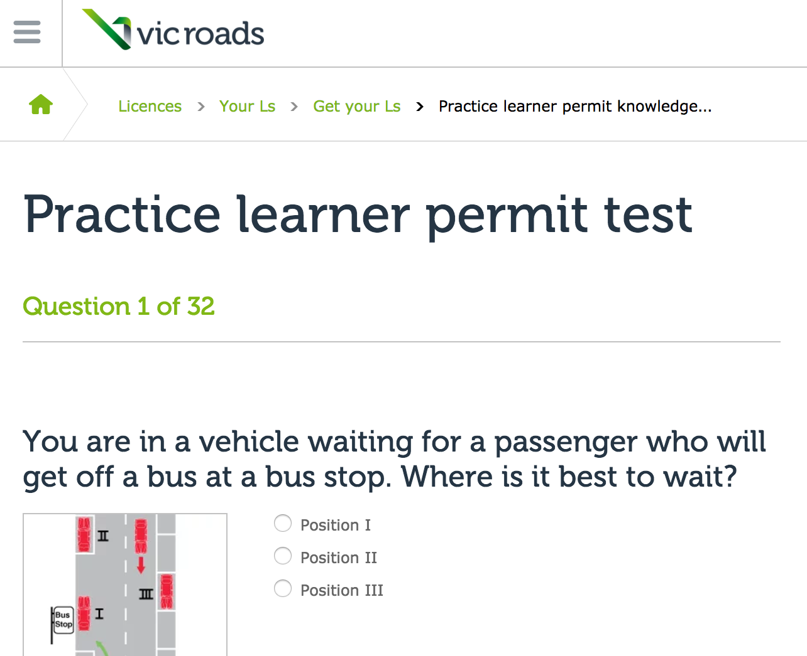
Do you need to study for the test?
Let’s see…..
https://www.vicroads.vic.gov.au/licences/your-ls/get-your-ls/lpt
This link is on the Weebly Under SURF

Slide 4
TASK -
Have a go at the 32 Questions for this practice test.
What were your results, did you make the 78% required?
Into what sections were the questions broken into? E.g. 1- Road rules
Is getting your L Plates something you hope to do as soon as possible?
Learner Log Book - explain what this is.

