Slide 1
Metre
Finding your rhythm and improving the flow of your poetry.

Slide 2
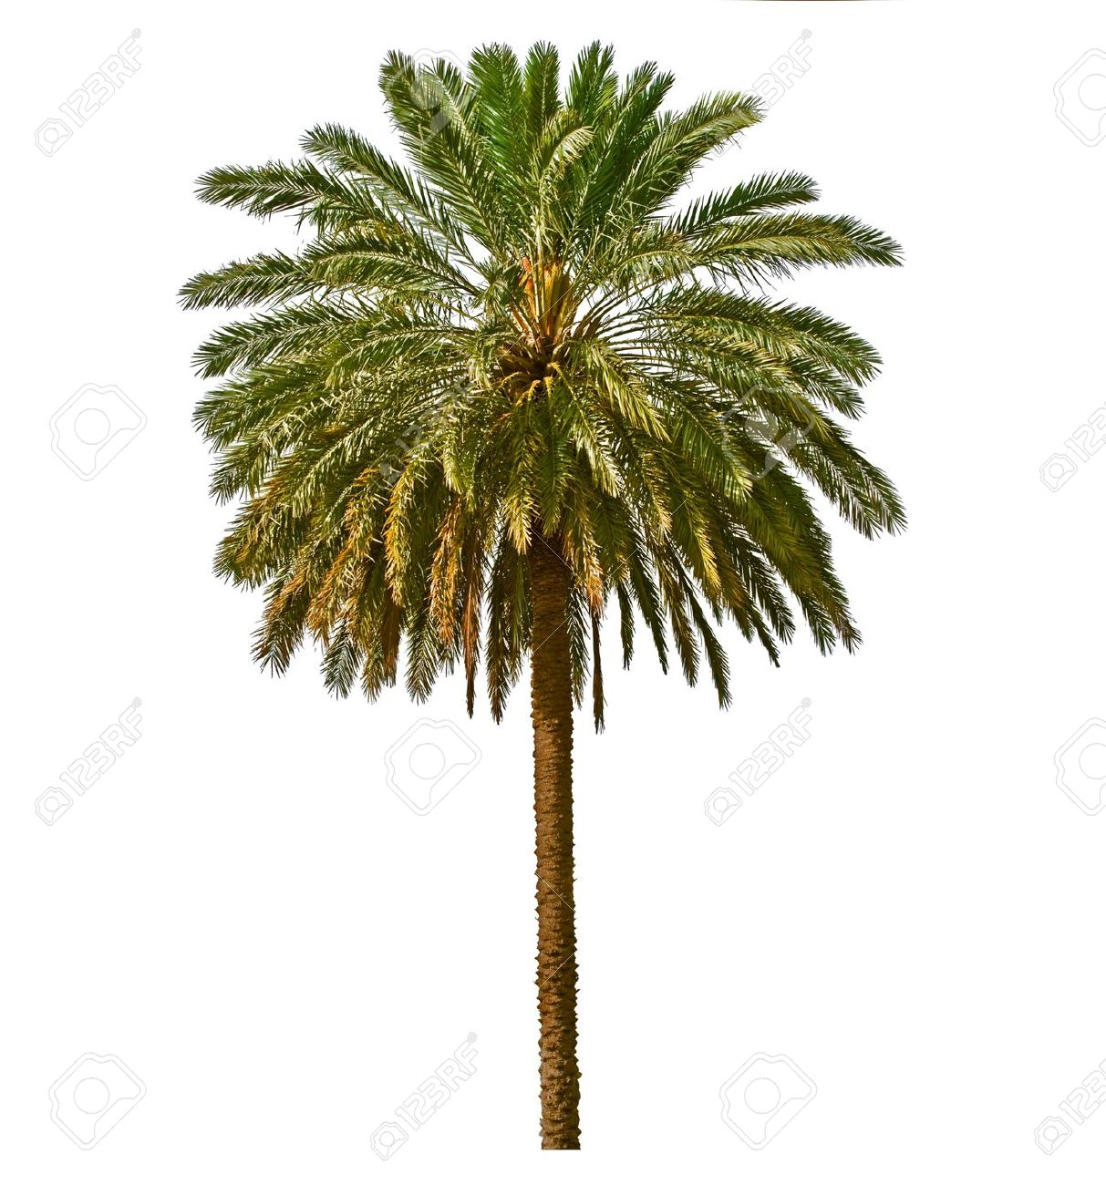
Limerick
There was a painter named Ernie, who took a long break under a big palm tree. when a coconut fell hit him on the head and sent him to hell, so he never did finish the marquee!
What do you think of this limerick?
Why is it so rubbish?

Slide 3
Limerick
There was a sign painter named Ernie, who took a break under a palm tree. when a coconut fell and sent him to hell, so he never did finish the marquee!
What do you think of this limerick?
Why is it so much better than the last one?

Slide 4
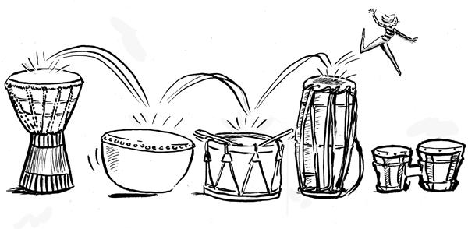
Rhythm
When you read rhyming poetry, one of the things you might notice is how the words often have a nice rhythmical quality. That is, there is a pattern to the rhythm of the words that makes them fun to say and easy to remember.
Poets arrange their words in such a way as to create those rhythmical patterns.

Slide 5
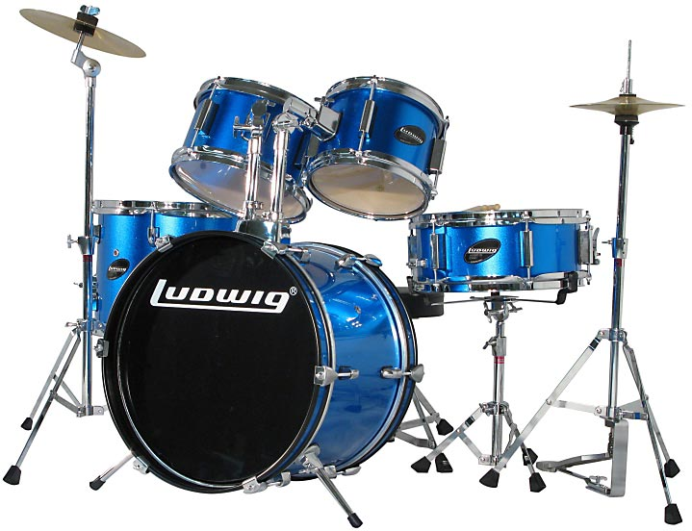
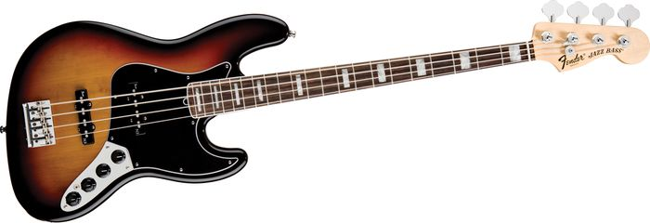
Rhythm
Poems don’t have instruments, so they rely on the words themselves.
In music, the rhythm of a song is the “beat,” often created by instruments such as drums, bass guitars, etc.

Slide 6
rhythm in words
The rhythm of a poem is set by the “stresses” or “accents” in the words themselves.
In most words that have more than one syllable, one of the syllables is pronounced more strongly than the others.
FOR EXAMPLE:
The word apple is pronounced “AP-pull” and not “ap-PULL.”

Slide 7
Example
Read the following line and see if you can hear the stressed syllables:
My mother ate an apple and my father ate a pear.
How did you go?
Notice any patterns?
Let’s make it a bit more obvious….
my MOTH-er ATE an AP-ple AND my FATH-er ATE a PEAR.
Now can you hear it? I hope you can see that, by writing your words in such a way that they form repeating patterns of stressed and unstressed syllables, you can add rhythm to your poems.

Slide 8
Definition
The rhythm created by stressed and unstressed syllables is called
“metre.”
https://www.youtube.com/watch?v=oNX2kxqvjbU

Slide 9
This photo was only discovered a few years ago. It was taken by a German soldier during the war and shows his view from the trench looking over the top.
Where is this?
We are going to practice our metre using this image as inspiration, but first, let’s brainstorm words to help us!

