Slide 1
Maths Practice Problems - 1
NO CALCULATOR For these Questions!

Slide 2
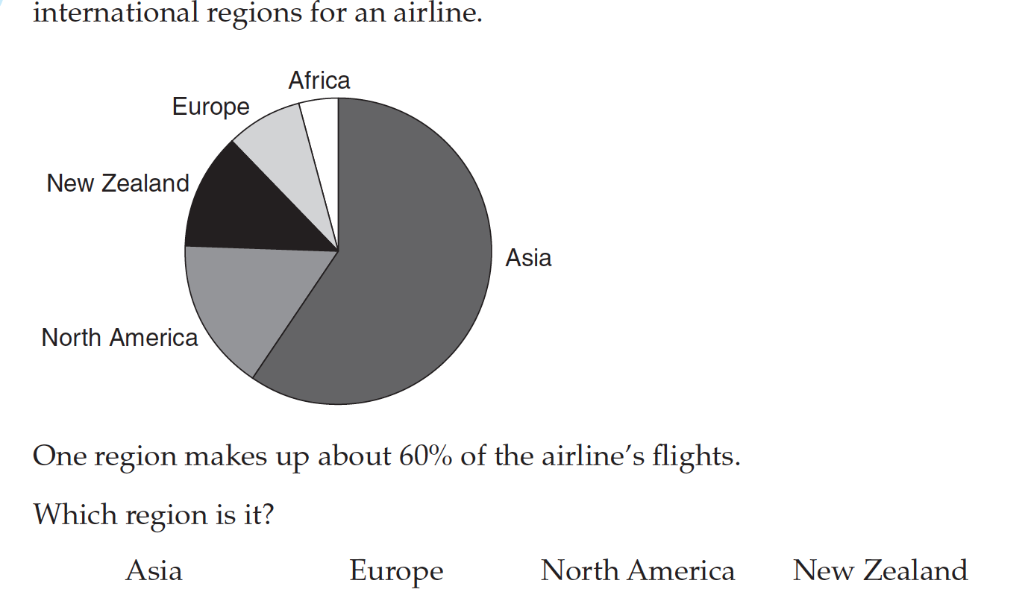
Percentages
Notes:
What are we looking for to help us here? What is the key information given to us and what is the question asking? Answer - Asia

Slide 3
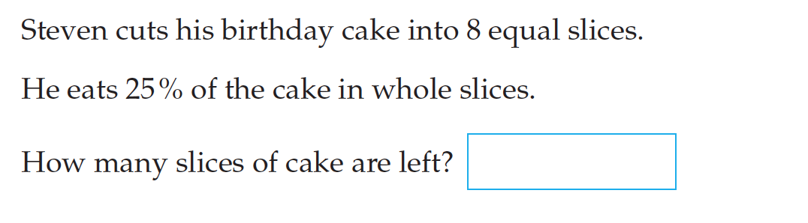
25%?
Notes:
What do we know about 25% to help us with this problem? What are some strategies we can use to solve it? Answer - 6

Slide 4
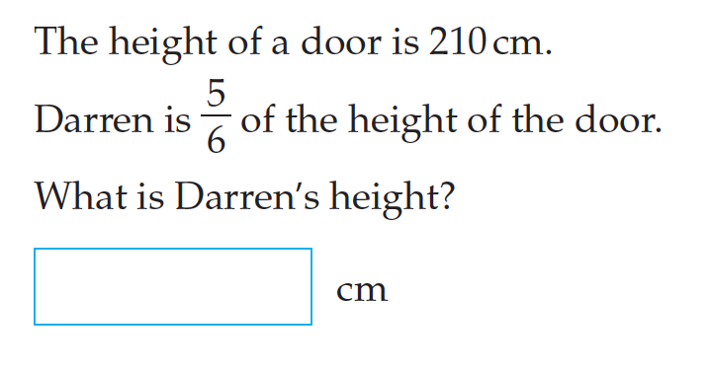
Fractions and decimals?
Notes:
Again there are a number of ways to solve this, what have you tried? Share. Start with splitting 210cm into 6 equal parts, how? So 1/6 would be? 2/6/? 3/6 or half? Answer - 175cm

Slide 5
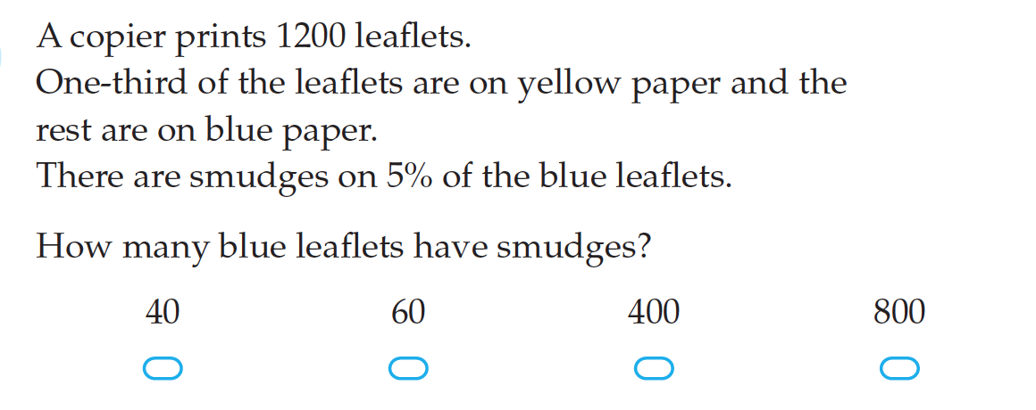
Multi step Problem…
Notes:
Identify the key information and what the question is actually asking us. ‘One third’ what does or can that look like? Have a go and share strategies. 5% not easy calculation without calculator…10% though is, can we find 10% and then halve it? How many copies are on Blue Paper? Answer - 40

Slide 6
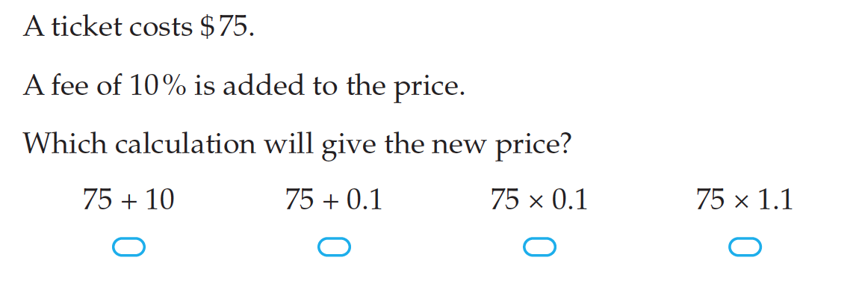
Quick ways to calculate 10%
Notes:
This question is seeing if you can convert a Percentage to a Decimal! What is 10% written as a decimal? What is 10% of 75? What is the answer we Need to get to? $82.50….which answer will get us to that? Which ones can we eliminate? ( a lot of kids will go 75 x 0.1 so discuss why and what they are actually calculating compared to actual question) Answer = 75 x 1.1

Slide 7
Practice?
How did you go with those?
Are there any areas you can focus on?
Anything you think you can use in future when you come across similar Questions?
Notes:
Read questions carefully, identify key information, eliminate answers in multiple choice, cross check check answers where possible.

